Slide 1
CSCE 1035 Computer Programming I Chapter 8 Lists and Dictionaries
University of North Texas

Slide 2

8.1 Lists

Slide 3

List Basics
A list is a sequence of values called items or elements
The elements can be of any data type
The list can be written as a list of comma-separated values (items) between square brackets
Lists are mutable, meaning that their elements can be changed
Creating a list
my_list = [] # empty list
my_list = [1, 2, 3] # list of integers
my_list = [1, 'Hello', 3.4] # list with mixed data types
my_list = ['Hi', [8, 4, 6]] # nested list
my_list = list() # empty list
my_list = list([1, 2, 3]) # list of integers
Using list constructor

Slide 4
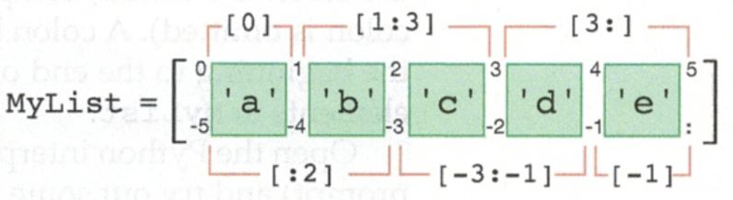
Accessing List Elements
Lists can be accessed using the index operator []
Lists use a zero-based index to match to a specific position in the list’s sequence of elements
A negative index means traversal from the end of the list

Slide 5
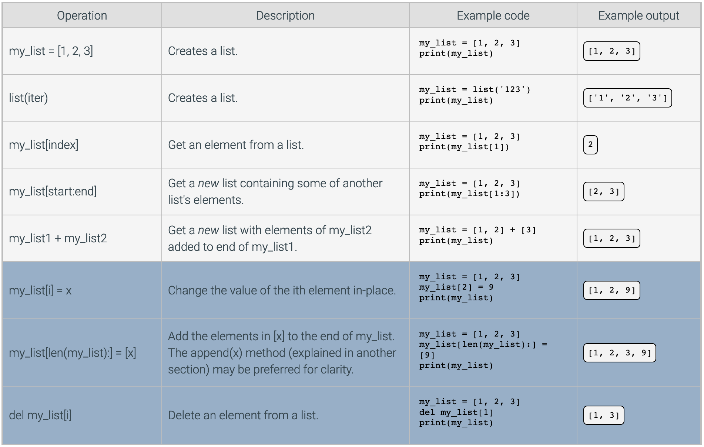
Common List Operations

Slide 6
8.2 List Methods

Slide 7
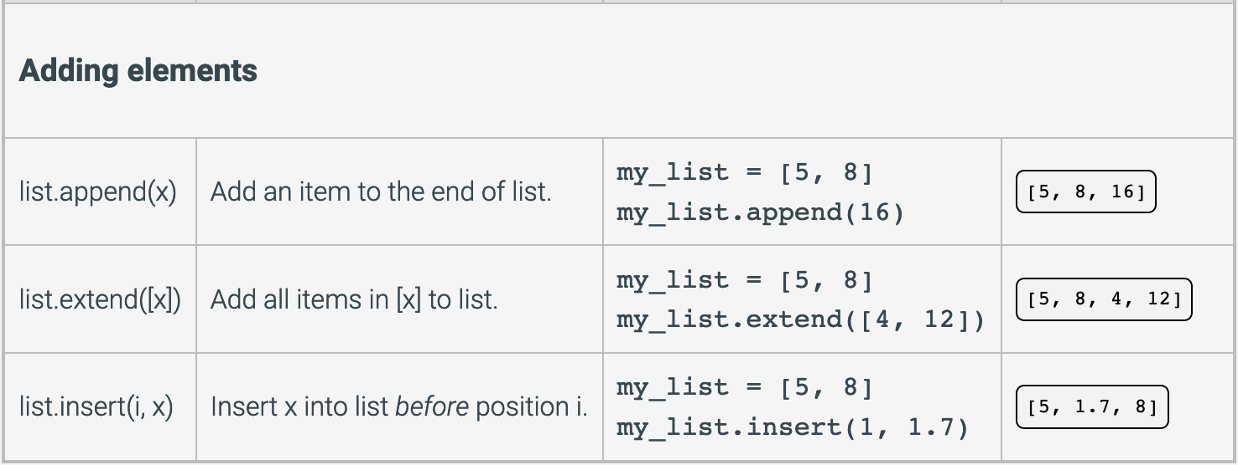
Adding List Elements

Slide 8
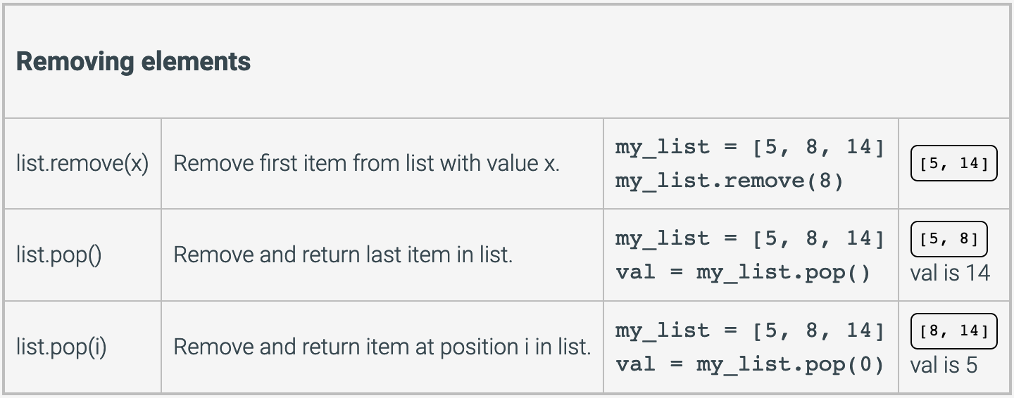
Removing List Elements
Create an empty list
list.clear()

Slide 9
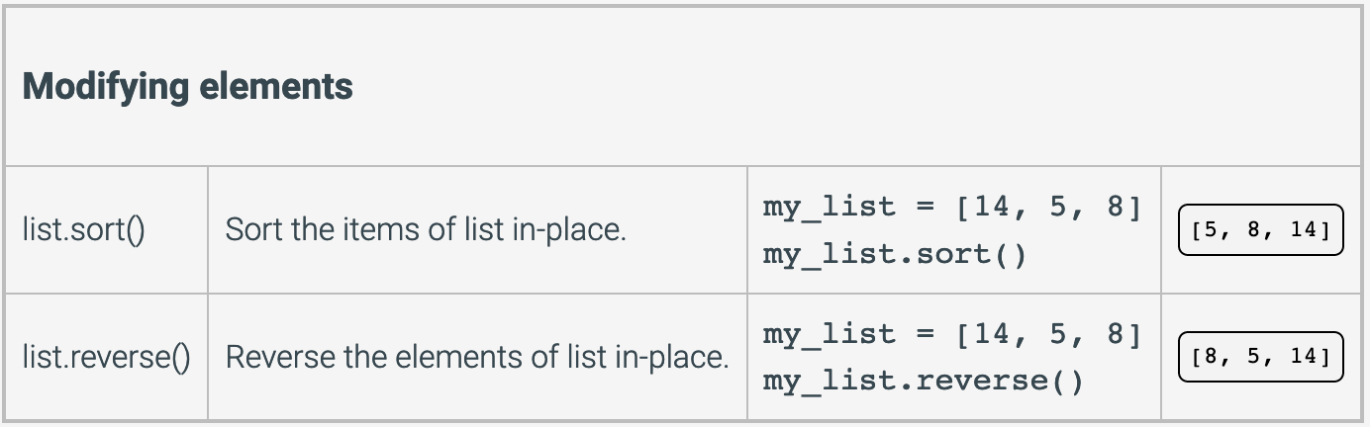
Modifying List Elements

Slide 10
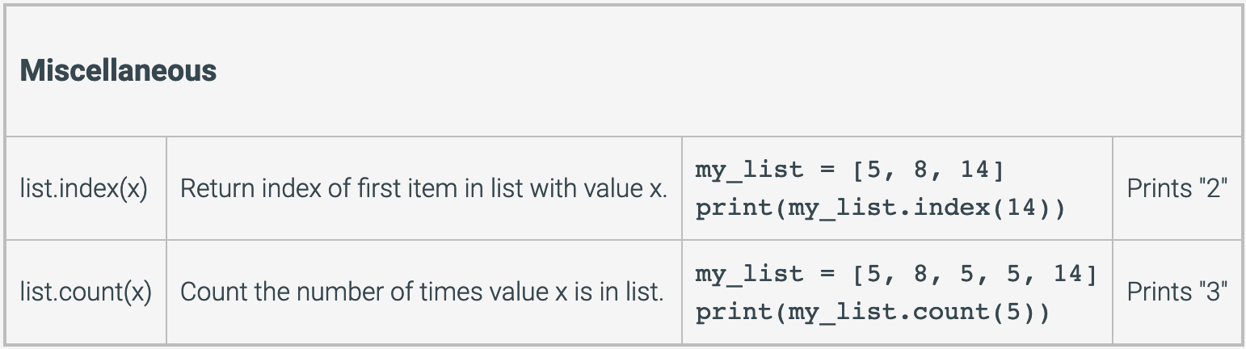
Miscellaneous List Operations

Slide 11
8.3 Iterating Over a List

Slide 12
List Iteration
A for loop steps through each item in a list
Each iteration of the loop creates a new variable by binding the next element of the list
The built-in enumerate() function iterates over a list and provides an iteration counter
>>> my_list = [90, 70]
>>> for index, value in enumerate(my_list):
... print(index, value)
...
0 90
1 70
General Format
for item in container:
loop body
additional statements

Slide 13
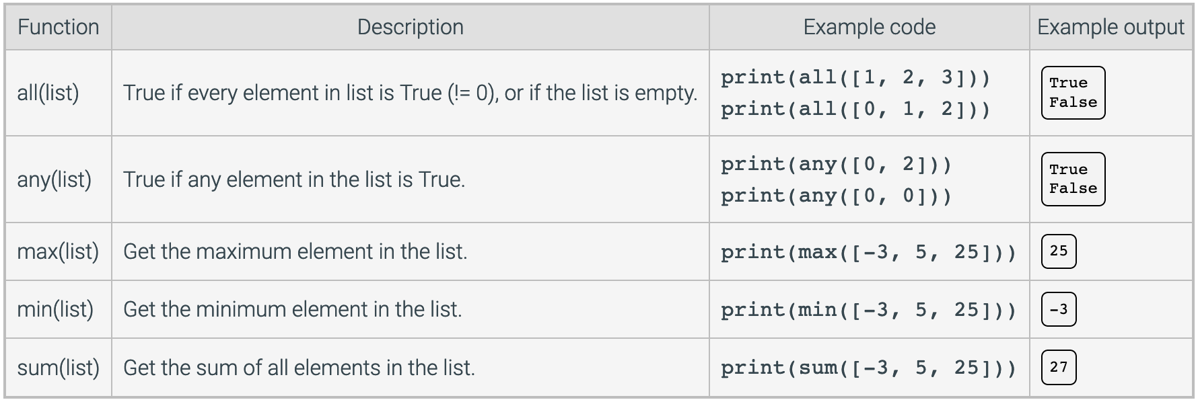
Built-In Iterating Functions

Slide 14
8.5 List Nesting

Slide 15
List Nesting
A list is a single-dimensional sequence of items
But a list can contain any type of object as an element, including another list
Embedding a list inside another list is known as list nesting
A nested list can be created by placing a comma-separated sequence of sublists
List nesting allows a programmer to create a multi-dimensional data structure, such as a two-dimensional table
Common to think of two-dimensional lists as having rows and columns
2-D structure can simulate objects like a spreadsheet or game board
To process data in a 2-D list, you need to use two indexes
Typically use nested loops to process

Slide 16
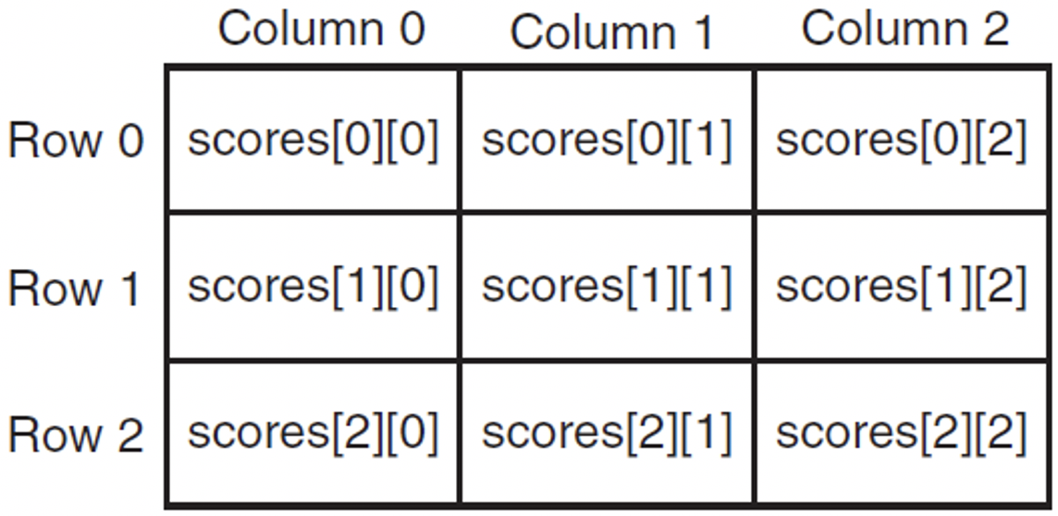
Accessing Nested List Items
Consider the following 2-D list called scores
>>> scores = [[89, 67, 41],
... [92, 88, 74],
... [71, 81, 93]]
Elements can then be accessed using subscripts

Slide 17
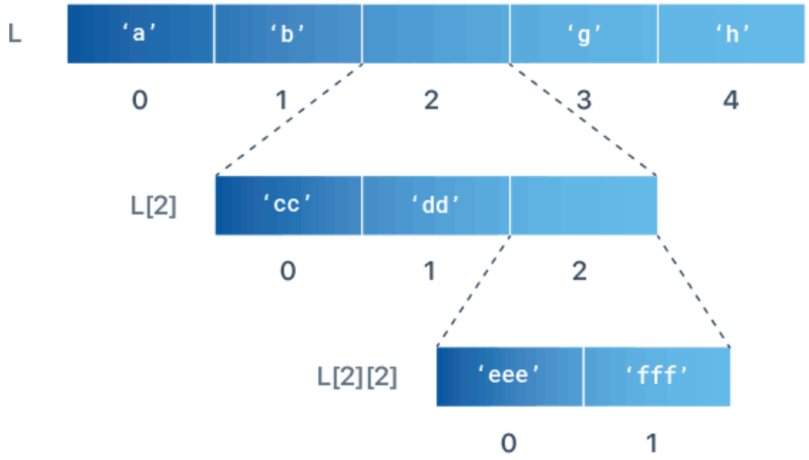
Indexing in a Nested List
>>> L = ['a', 'b', ['cc', 'dd', ['eee', 'fff']], 'g', 'h']
>>> print(L[2])
['cc', 'dd', ['eee', 'fff']]
>>> print(L[2][2])
['eee', 'fff']
>>> print(L[2][2][0])
eee

Slide 18
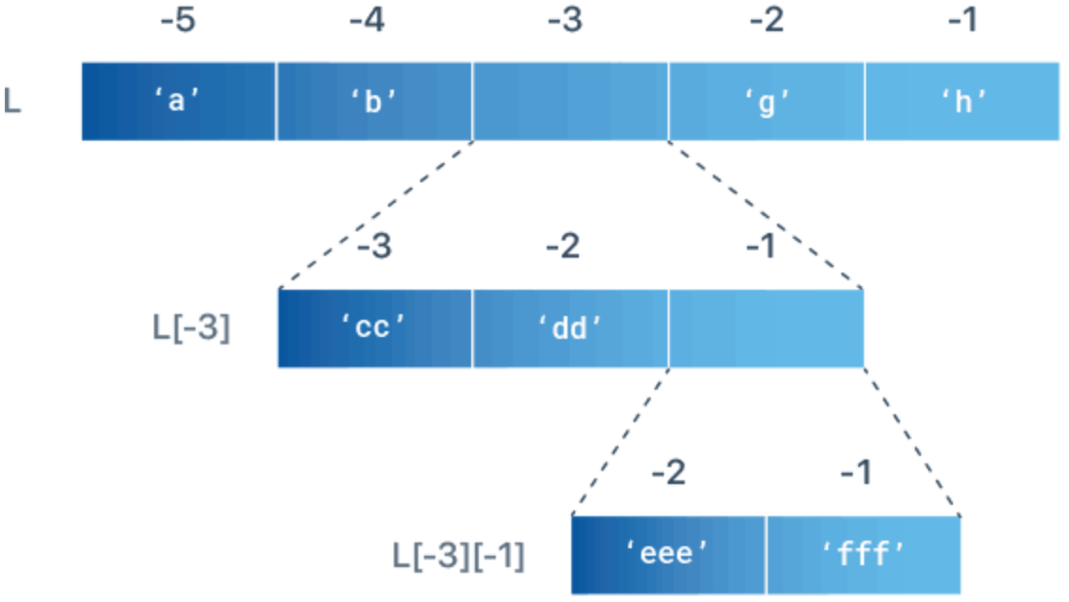
Negative Indexing in a Nested List
>>> L = ['a', 'b', ['cc', 'dd', ['eee', 'fff']], 'g', 'h']
>>> print(L[-3])
['cc', 'dd', ['eee', 'fff']]
>>> print(L[-3][-1])
['eee', 'fff']
>>> print(L[-3][-1][-2])
eee

Slide 19
Operating on Nested Lists
Find nested list length
>>> L = ['a', ['bb', 'cc'], 'd']
>>> print(len(L))
3
>>> print(len(L[1]))
2
Iterate through a nested list
>>> L = [[1, 2, 3],[4, 5, 6],[7, 8, 9]]
>>> for list1 in L:
... for number in list1:
... print(number, end=' ')
... print()
...
1 2 3
4 5 6
7 8 9

Slide 20
Changing Item Value in Nested List
Change item in a nested list using its index number
>>> L = ['a', ['bb', 'cc'], 'd']
>>> L[1][1] = 0
>>> print(L)
['a', ['bb', 0], 'd']

Slide 21
Adding Items to a Nested List
Using append() method
>>> L = ['a', ['bb', 'cc'], 'd']
>>> L[1].append('xx')
>>> print(L)
['a', ['bb', 'cc', 'xx'], 'd’]
Using insert() method
>>> L = ['a', ['bb', 'cc'], 'd']
>>> L[1].insert(0, 'xx')
>>> print(L)
['a', ['xx', 'bb', 'cc'], 'd’]
Using extend() method
>>> L = ['a', ['bb', 'cc'], 'd']
>>> L[1].extend([1, 2, 3])
>>> print(L)
['a', ['bb', 'cc', 1, 2, 3], 'd']

Slide 22
Removing Items from a Nested List
Using pop() method if you know the index of the item
>>> L = ['a', ['bb', 'cc', 'dd'], 'e']
>>> x = L[1].pop(1)
>>> print(L)
['a', ['bb', 'dd'], 'e']
>>> print(x)
cc
Using del statement if you don’t need the removed value
>>> L = ['a', ['bb', 'cc', 'dd'], 'e']
>>> del L[1][1]
>>> print(L)
['a', ['bb', 'dd'], 'e']
Using remove() method to delete by value
>>> L = ['a', ['bb', 'cc', 'dd'], 'e']
>>> L[1].remove('cc')
>>> print(L)
['a', ['bb', 'dd'], 'e']

Slide 23
8.6 List Slicing

Slide 24
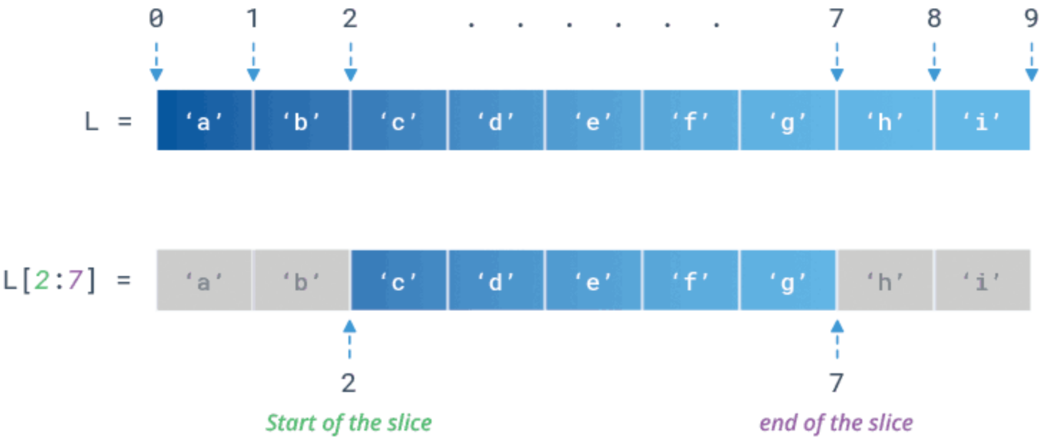
List Slicing
To access a range of items in a list, you need to slice a list using the slicing operator :
Slicing allows you to specify where to start the slicing, where to end, and the stride (or step)
If L is a list, the expression L[start : end : stride] returns the portion of the list from index start to index end, at a step size stride

Slide 25
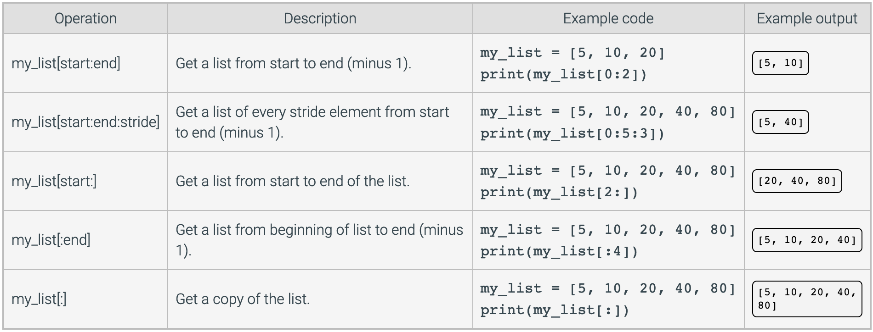
Common List Slicing Operations
Reverse a list by omitting both start and end indices and specifying a stride as -1
>>> L = ['a', 'b', 'c', 'd', 'e']
>>> print(L[::-1])
['e', 'd', 'c', 'b', 'a']

Slide 26
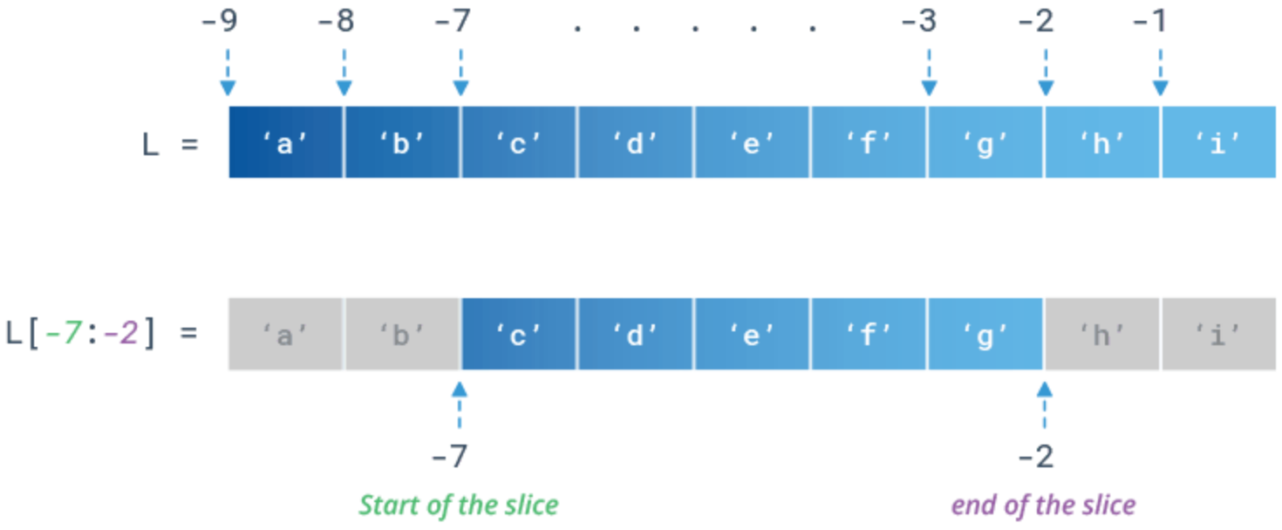
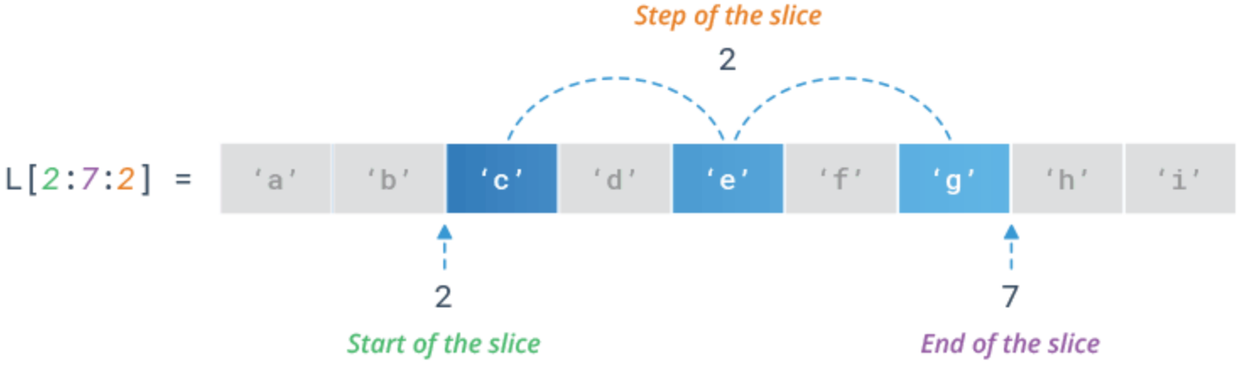
Common List Slicing Operations
Negative indices can also be used to count backwards from the end of the list
You can specify the step of the slicing using the optional stride parameter that defaults to 1

Slide 27
8.7 Loops Modifying Lists

Slide 28
Changing Element Values in List
Changing element values can require the index in the list
Combine len() and range() functions to iterate over a list
>>> my_list = [3, 5, 16, 12]
>>> for i in range(len(my_list)):
... my_list[i] += 5
...
>>> print(my_list)
[8, 10, 21, 17]
Can also use enumerate() method to obtain index
>>> my_list = [3, 5, 16, 12]
>>> for index, value in enumerate(my_list):
... my_list[index] = value + 5
...
>>> print(my_list)
[8, 10, 21, 17]

Slide 29
8.8 List Comprehensions

Slide 30
List Comprehensions
A list comprehension is a programming language construct for creating a list based on existing lists
The term is borrowed from math’s set comprehension notation for defining sets in terms of other sets
Generate a new list by applying a function to every member of an original list
The general syntax for a list comprehension is
list can be any collection of objects, like a list, tuple, etc.

Slide 31

List Comprehensions
>>> L = [x**2 for x in range(5)]
>>> print(L)
[0, 1, 4, 9, 16]
This list comprehension has two parts
The first part collects the results of an expression on each iteration and uses them to fill out a new list
The second part is exactly the same as the for loop, where you tell Python which iterable to work on
Every time the loop goes over the iterable, Python will assign each individual element to a variable x

Slide 32
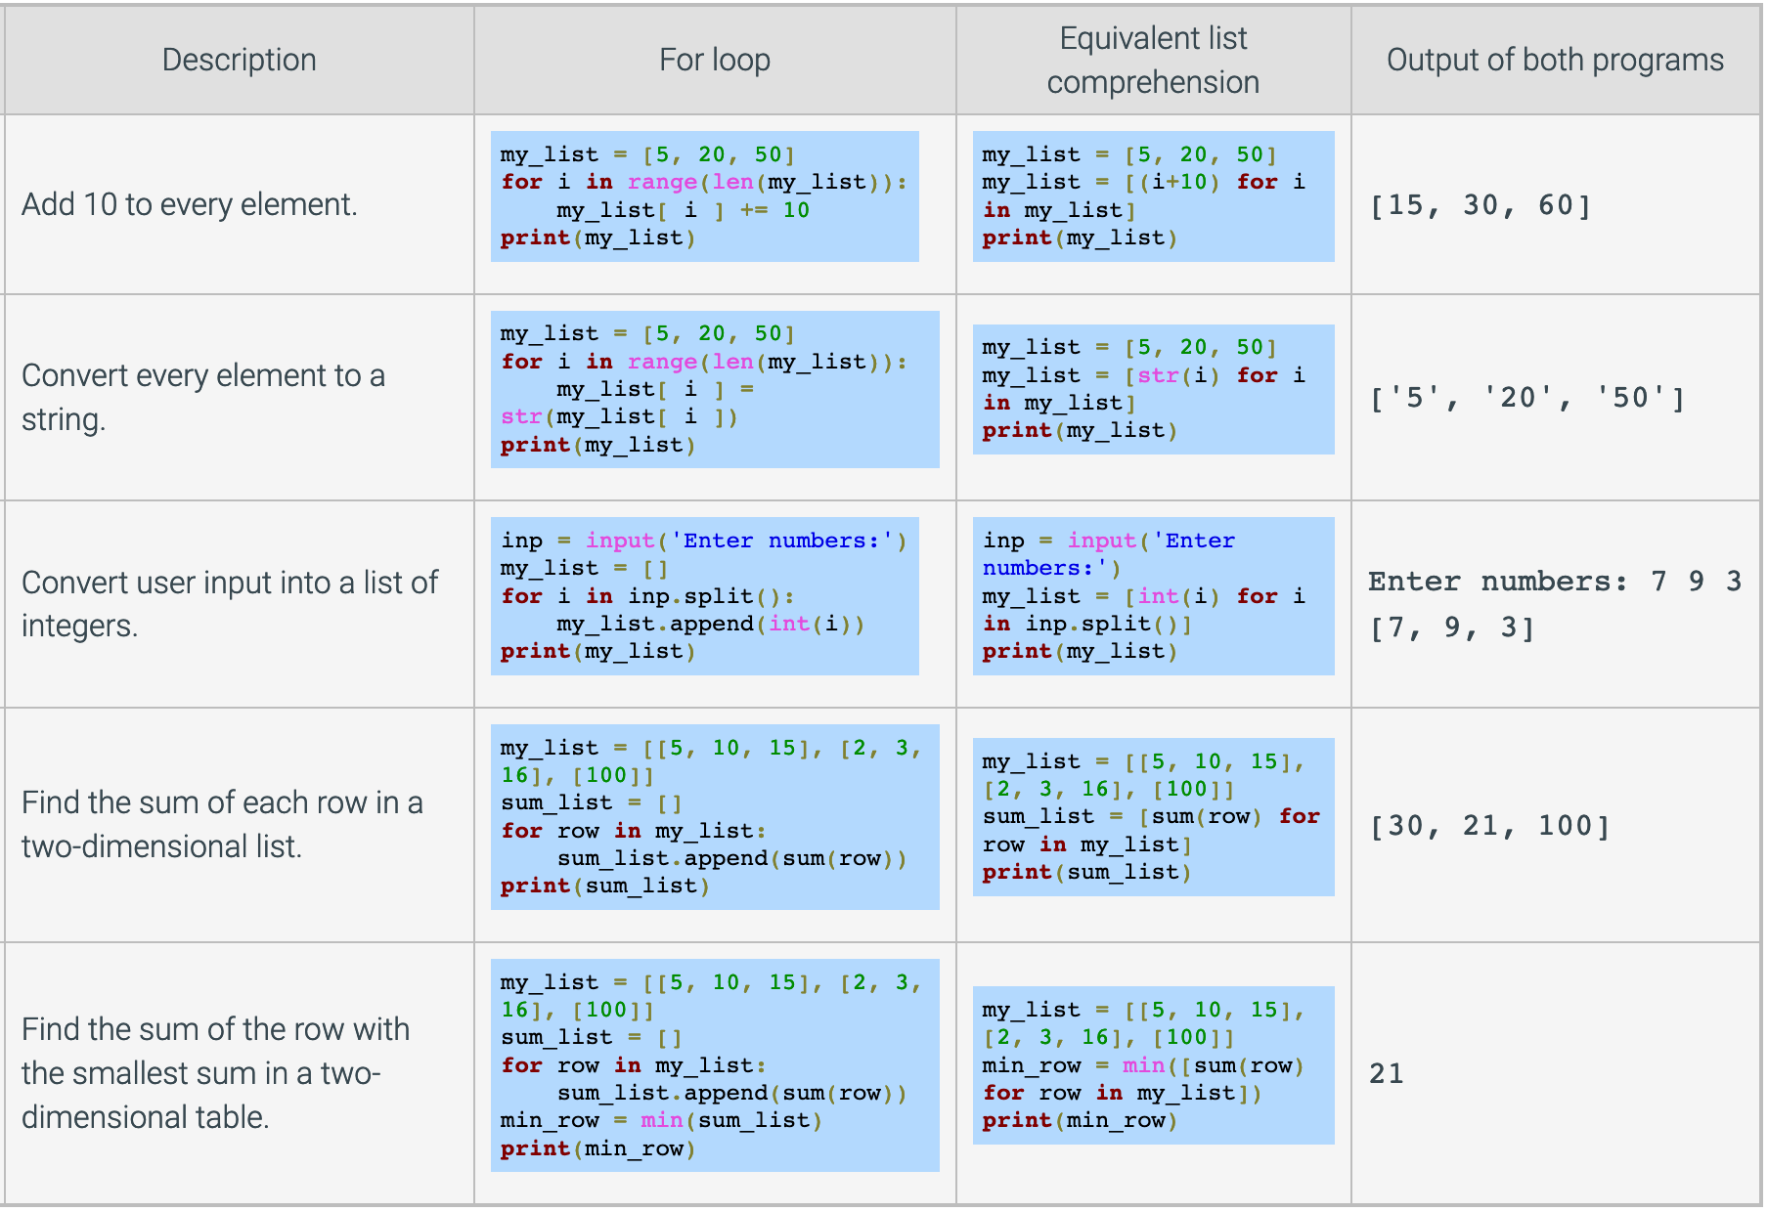
List Comprehensions

Slide 33
List Comprehensions
If the elements of list are other containers, then name can consist of a container of names matching the type and "shape" of the list members
>>> L = [('a', 1), ('b', 2), ('c', 7)]
>>> [ n * 3 for (x, n) in L]
[3, 6, 21]
expression can also contain user-defined functions
>>> def subtract(a, b):
... return a - b
...
>>> list1 = [(6, 3), (1, 7), (5, 5)]
>>> [subtract(y, x) for (x, y) in list1]
[-3, 6, 0]

Slide 34
Conditional List Comprehensions
The condition, or filter, determines whether expression is performed on each member of the list
For each element of list, checks if it satisfies the filter condition
If the filter condition returns False, that element is omitted from list before the list comprehension is evaluated
>>> L = [3, 6, 2, 7, 1, 9]
>>> [elem * 2 for elem in L if elem > 4]
[12, 14, 18]

Slide 35
Nested List Comprehensions
The initial expression in a list comprehension can be an expression, including another list comprehension
>>> L = [3, 2, 4, 1]
>>> [elem * 2 for elem in
... [item + 1 for item in L] ]
[8, 6, 10, 4]
The inner comprehension produces [4, 3, 5, 2]
So the outer comprehension produces [8, 6, 10, 4]

Slide 36
8.9 Sorting Lists

Slide 37
Sorting Lists
The sort() method performs in-place rearranging of list elements, comparing element-by-element to determine the final ordering
Usual relational comparison rules are followed
Numbers compare their values
Strings compare their ASCII encoded values
Consider the following example
>>> my_list = [4, 7, 1, 2]
>>> my_list = my_list.sort()
>>> print(my_list)
None
sort() changes the order of list in-place, so nothing is returned
For this kind of operation, use the sorted() built-in function that returns a new list instead of modifying an existing list
What happened?

Slide 38
Sorting Lists
Both the sort() method and built-in sorted() function have an optional key argument
The key specifies a function to be applied to each element prior to being compared, such as len, str.lower, or str.capitalize
>>> my_list = ['bread', 'talk', 'apple', 'industrious']
>>> my_list.sort(key=len)
>>> print(my_list)
['talk', 'bread', 'apple', 'industrious’]
Sorting also supports the reverse argument, which can be set to a Boolean value
>>> L = ['red', 'green', 'blue', 'orange']
>>> sorted(L, reverse=True)
['red', 'orange', 'green', 'blue']

Slide 39
8.10 Command-Line Arguments

Slide 40
Command Line Arguments
Command line arguments are input parameters passed to the Python script when executing them
Enclose argument within double quotes "…" if contains a space
The Python sys module provides access to any command-line arguments using sys.argv that serves two purposes
sys.argv is the list of command-line arguments as strings
len(sys.argv) is the number of command-line arguments
You can store arguments given at start of program in variables
var1 = sys.argv[1]
You can test for number of arguments passed to the program
if len(sys.argv) != 3:
print('Too few arguments')

Slide 41
8.12 Dictionaries

Slide 42
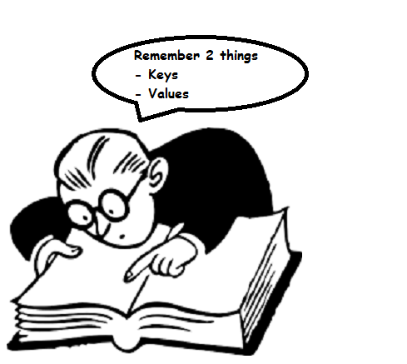
Dictionaries
Dictionaries are Python’s built-in mapping type
A mapping is an arbitrary collection of objects indexed by arbitrary values called keys (not by the position in the list)
Values are arbitrary objects, may be of different types
Dictionaries are mutable, not ordered
Concatenation, slicing, and other operations that depend on the order of elements do not work on dictionaries
Items in a dictionary form a key-value pair
Can grow and shrink in place like lists

Slide 43
Creating Dictionaries
Use a series of pairs of expressions, separated by commas within braces
>>> my_dict = {'x': 42, 'y': 3.14, 26: 'z'}
>>> print(my_dict)
{'x': 42, 'y': 3.14, 26: 'z’}
Use the dict() function using keyword arguments to specify key-value pairs or by specifying a list of list- or tuple-pairs
>>> my_dict = dict(x = 42, y = 3.14)
>>> print(my_dict)
{'x': 42, 'y': 3.14}
>>> my_dict = dict([[1, 2], [3, 4]])
>>> print(my_dict)
{1: 2, 3: 4}

Slide 44
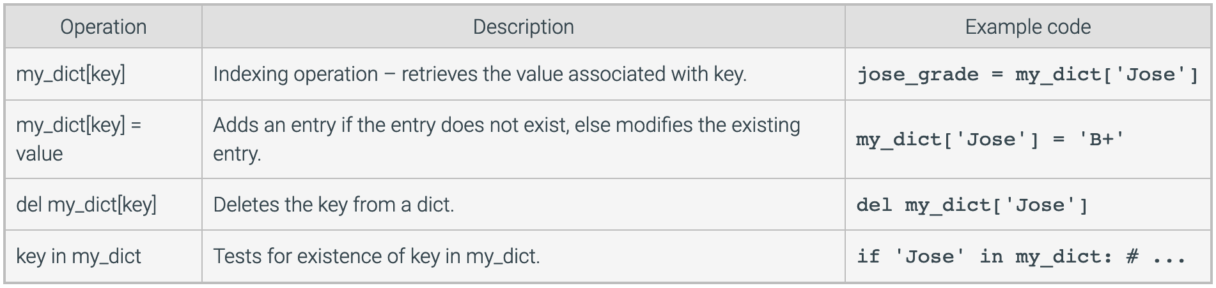
Common Dictionary Operations

Slide 45
Dictionary Methods
To visualize the methods and attributes of a dictionary, you can see all the methods and attributes that dictionaries implement
>>> dir(dict)
['__class__', '__contains__', '__delattr__', '__delitem__', '__dir__', '__doc__', '__eq__', '__format__', '__ge__', '__getattribute__', '__getitem__', '__gt__', '__hash__', '__init__', '__init_subclass__', '__iter__', '__le__', '__len__', '__lt__', '__ne__', '__new__', '__reduce__', '__reduce_ex__', '__repr__', '__setattr__', '__setitem__', '__sizeof__', '__str__', '__subclasshook__', 'clear', 'copy', 'fromkeys', 'get', 'items', 'keys', 'pop', 'popitem', 'setdefault', 'update', 'values’]
Can also use dir({})

Slide 46
8.13 Dictionary Methods

Slide 47
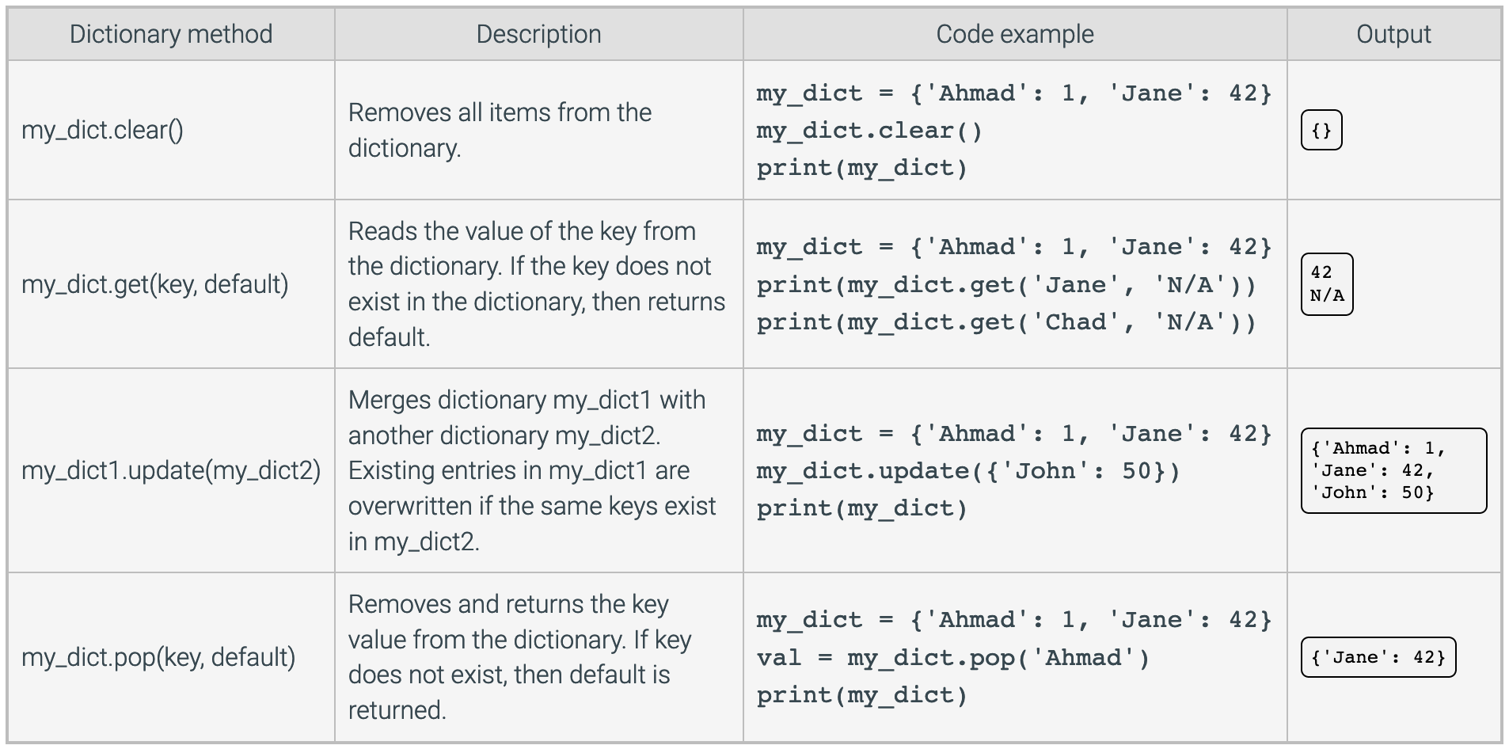
Dictionary Methods

Slide 48
8.14 Iterating Over a Dictionary

Slide 49
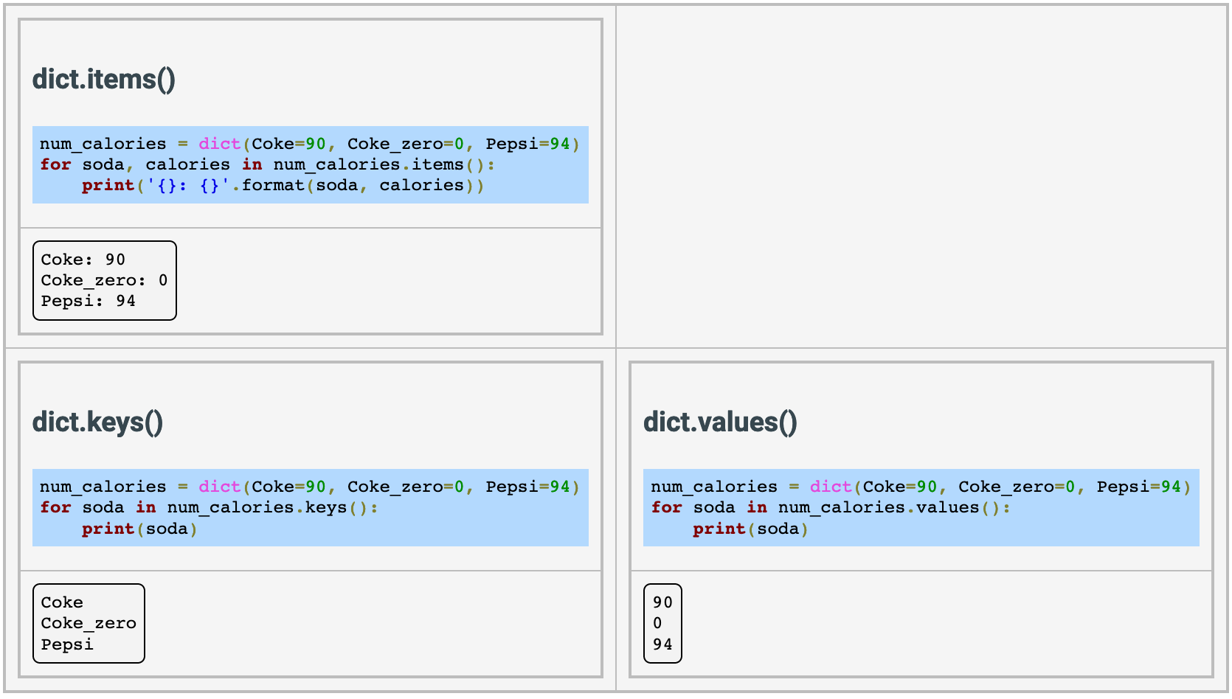
Iterating over a Dictionary

Slide 50
8.15 Dictionary Nesting

Slide 51
Dictionary Nesting
A dictionary may contain one or more nested dictionaries, in which a dictionary contains another dictionary as a value
>>> nested_dict = {'dictA': {'key_1': 'value_1'},
... 'dictB': {'key_2': 'value_2'}}
>>> print(nested_dict)
{'dictA': {'key_1': 'value_1'}, 'dictB': {'key_2': 'value_2’}}
Indexing operations can be applied to the nested dictionary by using consecutive sets of brackets []

